Slide 1
Hidden Messages Everywhere: JavaScript Implementation of Steganography
BootCon 2022: Erin Ngo Final Project

Slide 2
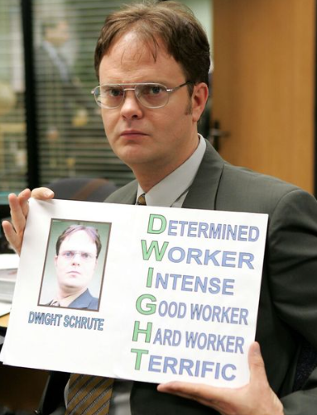
Read Through This Paragraph: Cybersecurity The Early Years
Historically, the cybersecurity field began in the early 1970’s.It did not account for such things as ransomware, viruses, and logic bombs.Dangers to networks back then,were limited to malicious insiders gaining access to documents they were not perhaps authorized to view. Deploying a virus as a weapon first happened when a German hacker Marcus Hoss used a gateway at Berkeley to gain access to roughly 400 military computers connected to ARPAnet. Extraordinarily, an Berkeley astronomer, Clifford Stoll noticed the intrusion, created a honeypot and foiled the plot. Notably, this attack started the use of viruses as an intrusion mechanism and no longer a curious academic pursuit. In the mid 1970’s, Robert Thomas, a researcher at BBN (Bolt Beranek and Newman, now Raytheon)created a program able to move in a network and leaving behind a trail creating the first computer worm. Needling its way through Tenex terminals networks, this worm was called the Creeper printing, in all caps, “I’M THE CREEPER: CATCH ME IF YOU CAN”. Printing a benign message soon became the least of anyone’s concern. Learning from the work of Robert Thomas, Robert T Morris, a graduate student at Cornell University, curious about the size of the internet, created a worm in 1988 to gauge it. Leveraging a known vulnerability in UNIX terminals, it would propagate itself across a set of networks and replicate itself. As a result, networks clogged causing all connected systems to crash. In essence, the Internet slowed down to a crawl. Needless to say, this worm left untold damage in its wake and was the first worm to receive full media coverage along with being one of the first programs written to exploit system vulnerabilities. Sentenced and fined $10,000 Morris became the first person charged under the Computer Fraud and Abuse Act. Interestingly, though dismissed from Cornell, Morris then went on to become a tenured MIT professor. Governance equally followed the Morris worm with the creation of the Computer Emergency Response Team, the forerunner of the modern US-CERT. However, the Morris worm did also inspire others to research how to make more insidiously effective worms and viruses.The Morris worm compared to the viruses of the mid to late 1990’s such as the I LOVE YOU and Melissa viruses that infected tens of millions of computers causing the failure of email systems,garnered even more headline news, making the Morris worm seem nothing more than a mild inconvenience.
Notes:
Not to worry I realized this slide is not going to win any UX/UI accessibility awards.
I’ll give you a couple of moments. It’s totally okay if you don’t finish it either. Here’s a hint.

Slide 3
Read Through This Paragraph: Cybersecurity The Early Years
Sentenced and fined $10,000 Morris became the first person charged under the Computer Fraud and Abuse Act.
Interestingly, though dismissed from Cornell, Morris then went on to become a tenured MIT professor.
Governance equally followed the Morris worm with the creation of the Computer Emergency Response Team, the forerunner of the modern US-CERT.
However, the Morris worm did also inspire others to research how to make more insidiously effective worms and viruses.
The Morris worm compared to the viruses of the mid to late 1990’s such as the I LOVE YOU and Melissa viruses that infected tens of millions of computers causing the failure of email systems,garnered even more headline news, making the Morris worm seem nothing more than a mild inconvenience.
Historically, the cybersecurity field began in the early 1970’s.
It did not account for such things as ransomware, viruses, and logic bombs.
Dangers to networks back then,were limited to malicious insiders gaining access to documents they were not perhaps authorized to view.
Deploying a virus as a weapon first happened when a German hacker Marcus Hoss used a gateway at Berkeley to gain access to roughly 400 military computers connected to ARPAnet.
Extraordinarily, an Berkeley astronomer, Clifford Stoll noticed the intrusion, created a honeypot and foiled the plot.
Notably, this attack started the use of viruses as an intrusion mechanism and no longer a curious academic pursuit.
Printing a benign message soon became the least of anyone’s concern.
Learning from the work of Robert Thomas, Robert T Morris, a graduate student at Cornell University, curious about the size of the internet, created a worm in 1988 leveraging a known vulnerability in UNIX terminals.
As a result, networks clogged causing all connected systems to crash.
In essence, the Internet slowed down to a crawl.
Needless to say, this worm left untold damage in its wake and was the first worm to receive full media coverage along with being one of the first programs written to exploit system vulnerabilities.
In the mid 1970’s, Robert Thomas, a researcher at BBN (Bolt Beranek and Newman, now Raytheon),created a program able to move in a network and leaving behind a trail creating the first computer worm.
Needling its way through Tenex terminals networks, this worm was called the Creeper printing, in all caps, “I’M THE CREEPER: CATCH ME IF YOU CAN”.
Notes:
It is an acrostic paragraph that hides the idiomatic expression : Hidden In Plain Sight. Or if I put it another way: Each new sentence within the paragraph, so each capital, spells out Hidden in Plain Sight. Hopefully this didn’t make any of you feel silly for not noticing. That is sort of the point. And to be fair that was objectively a huge novella I just put on screen. The best version of this I’ve seen was an essay that did this that spelt out HELP ME!

Slide 4
Hidden Messages Everywhere: Overview
Steganography Refresher
Understanding What’s Going On Under the Hood
Project : JS Code Implementation
Experiment with JS Code Implementation
Round Up and Questions.
Notes:
Here’s a quick overview of the presentation. I’ll try to keep it SUPER fun. So first will start with what is Steganography. This will be followed by the Why: Why did I pick steganography along with trying to understand what is going on under the hood. Then I will show you my actual Project in terms of a video presentation of me coding through a front end implementation of Steganography. This will be followed up with an experimental website I then created using my code implementation followed up by a round up and your general steganography questions.

Slide 5
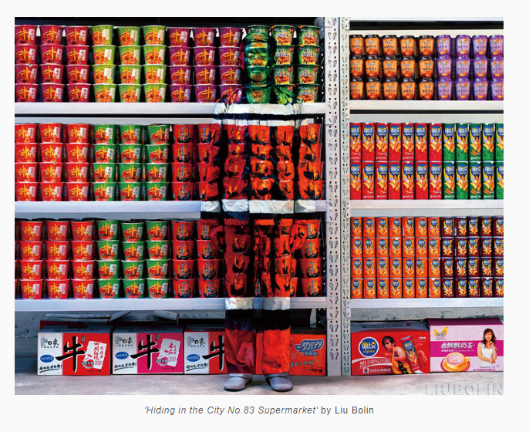
Steganography:
Steganography is the practice of concealing a message within another message or physical object. It comes from the Greek steganos which means covered or concealed and graphia which means writing.
Or if you are a more visual person
Notes:
Though this work by contemporary Chinese artist Liu Bolin is protesting the rapid pace of development in urban neighborhoods I think it really captures what the spirit of what steganography is about.

Slide 6
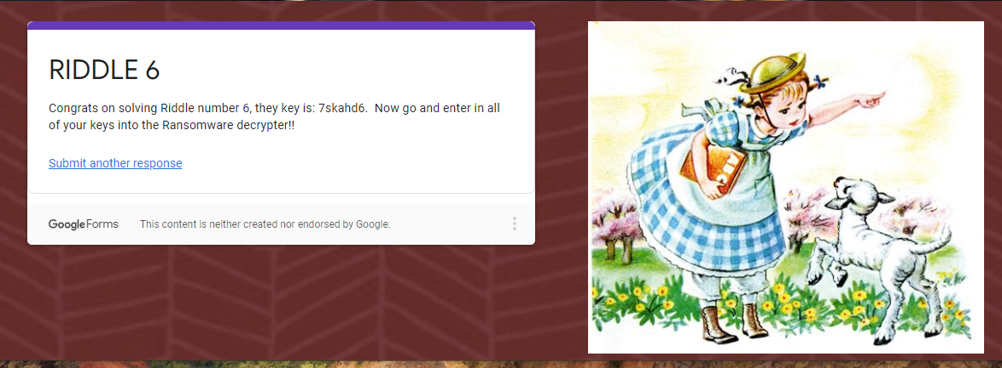
Hidden Messages Everywhere: Why?
Notes:
Out of all the units we have covered, by far I found the cryptography unit the most fascinating. I really loved the Die Hard Hospital assignment.

Slide 7
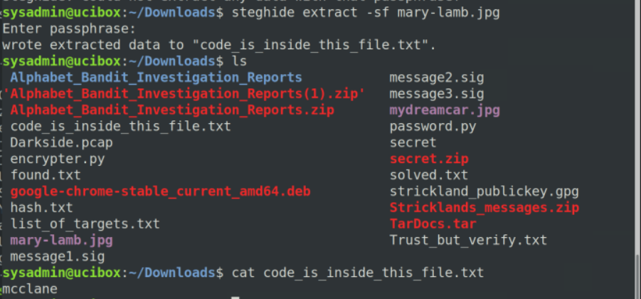
Hidden Messages Everywhere: Why?
Notes:
I enjoyed working my way through all the riddles and especially using the steghide suite. However, this is too tidy and neat of an explanation for me and doesn’t really explain what is going on under the hood when you run the steghide program.

Slide 8
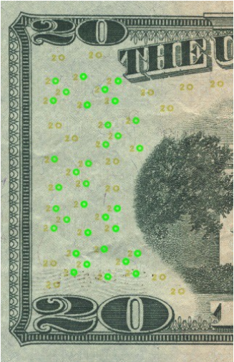
Hidden Messages Everywhere: Why?
Notes:
In researching a little I found out these interesting Steg facts which I think are useful to keep in mind. 1. Steganography is already implemented in our day to day mundane objects like currency. Those little green circles are called the Eurion constellation because they bear a passing resemblance to the Orion constellation and have been placed in banknotes since 1996. And design wise are are often passed off as flowers or musical notes. And since most modern scanners are nothing short of amazing they actually have counterfeit deterrent systems in place that if any part of a bill is detected, the simply stop scanning the bill.

Slide 9


Hidden Messages Everywhere: Why?
Original 25x Less Color
Notes:
More crucially, I discovered that while there are two kinds of steganography one that overlays a patterns on top of a carrier file in the hopes that it can be recovered later and the other that relies on the numeric alteration of data in an image, or changing the least significant bits of an image. This last one to me is truly stunning as it relies on the fact that we as humans really cannot tell the difference.

Slide 10
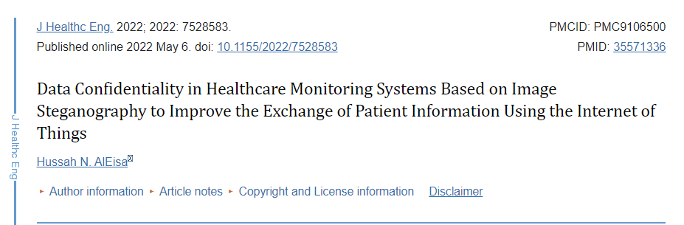
Hidden Messages Everywhere: Why?
Notes:
Lastly, why I think steganography is interesting and probably one to watch in cryptography is because it can solve modern problems of distance diagnosing and perhaps less crucially it could substantially solve some of the problems in the NFT arena as it could provide a means of creating a digital provenance and eliminating a certain degree of fraudulent NFT scams.

Slide 11
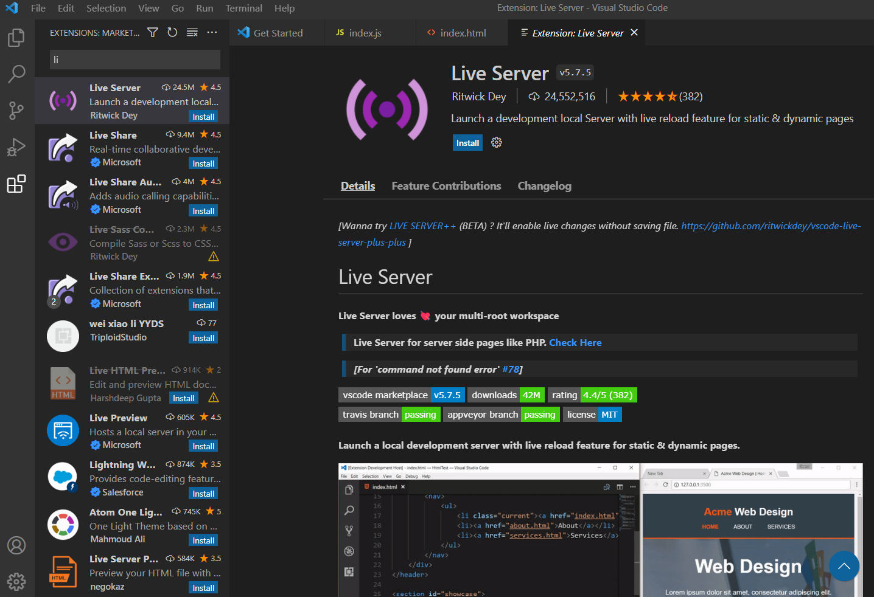
Hidden Messages Everywhere: How
This what I used to code my front end implementation of a steganography library:
Live Server Add On for VS Code.
Notes:
For my implementation of a steganography suite I used VS Code with a Live Server add on. I find this add on really useful generally as it let’s you work on your development projects in real time and lets you see your coding changes in real time. It also really easy to add on to VS Code so I would say go ahead and get it.

Slide 12
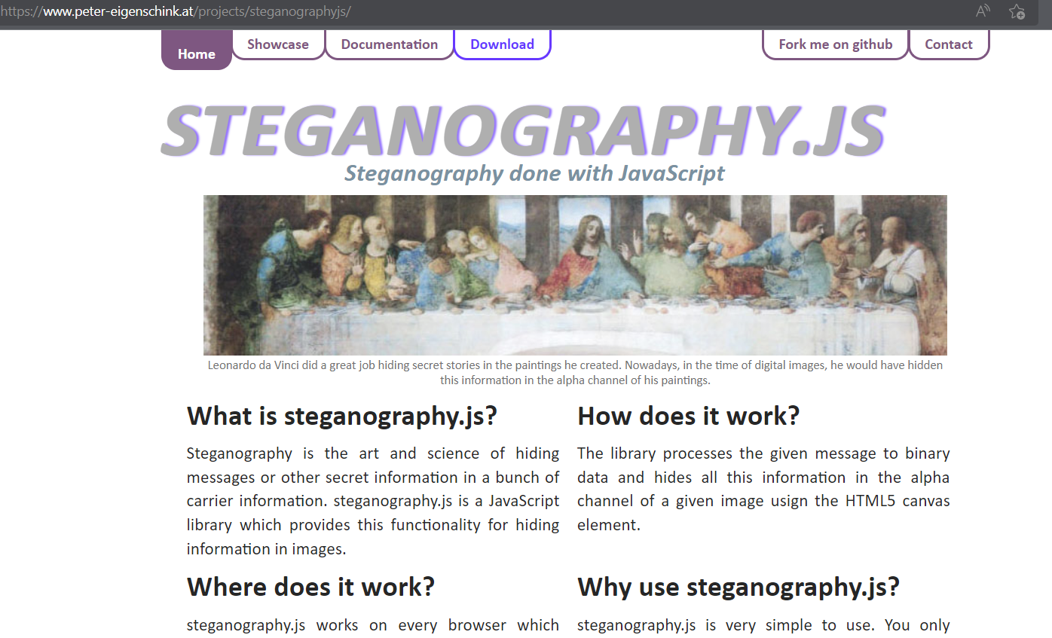
Hidden Messages Everywhere: How
This what I used to code my front end implementation of a steganography library:
2. Steganography.JS
Notes:
This is a library designed by an Austrian software developer Peter Eigenshink. It’s a pretty tidy library that when you look at the documentation it been floating around for awhile and the last time it was updated was in 2017. This is the primary library I used for my code implementation. It is a steganography implementation that uses the least significant bit algorithm to encode it's messages into images.

Slide 13
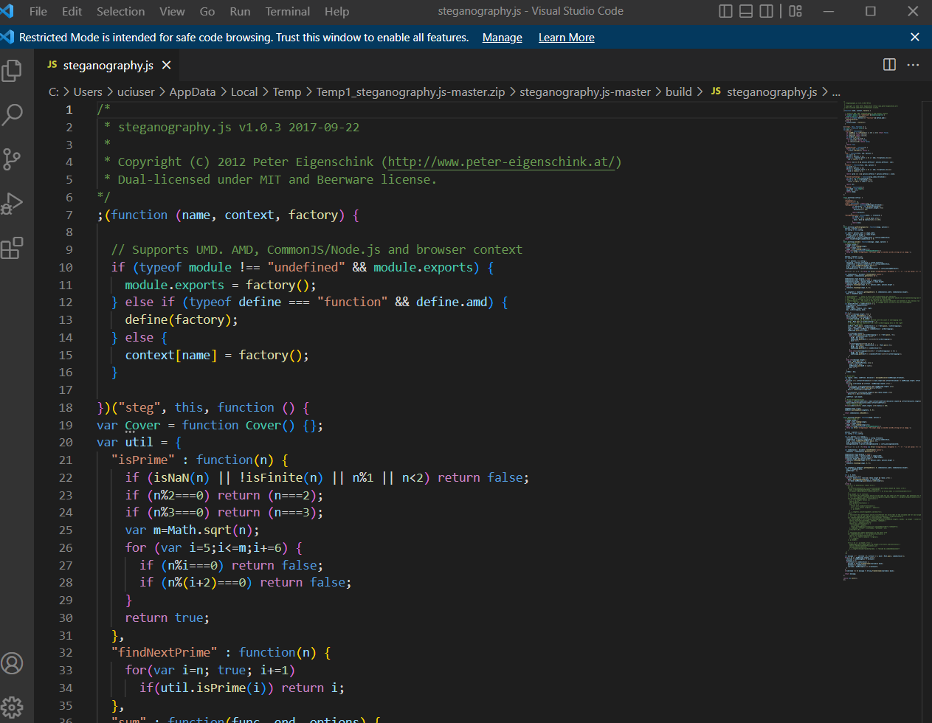
Hidden Messages Everywhere: How
This what I used to code my front end implementation of a steganography library:
2. Steganography.JS
Notes:
To that point, when you download the library you encounter two files in the build folder this is a screenshot of the the actual entire code library. It's a pretty length file with over 500 lines of code. Needless to say it's complicated.

Slide 14
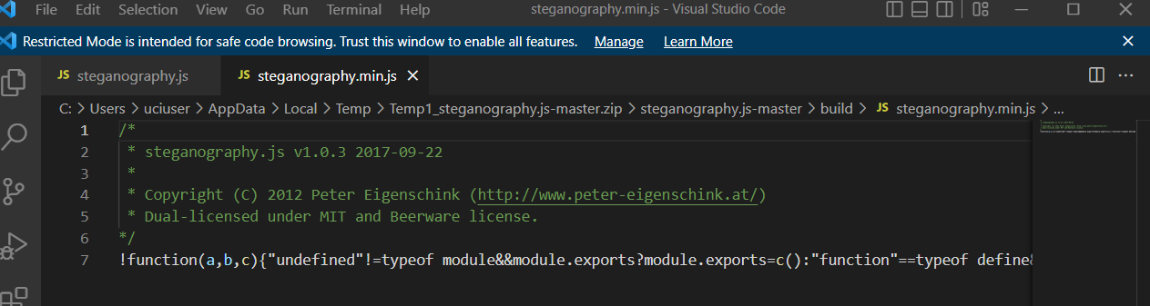
Hidden Messages Everywhere: How
This what I used to code my front end implementation of a steganography library:
2. Steganography.JS
Notes:
What I used for my code implementation is the other file in the build folder: the minified version. This takes the entire file and places it in one line. While this does make the file not as human readable like the other file, it does make it faster in terms of processing speed. So this is the version of the steganography.js you will see in my code implementation.

Slide 15
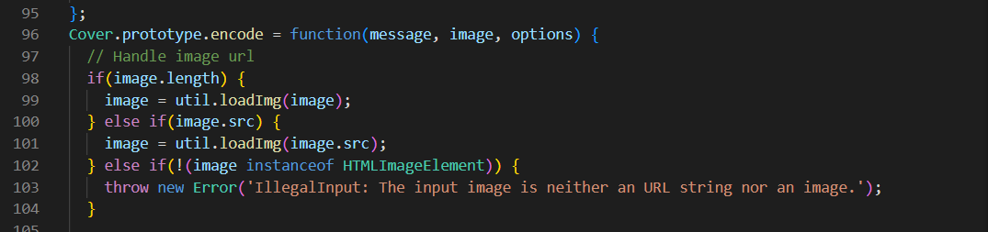
Hidden Messages Everywhere: How
This what I used to code my front end implementation of a steganography library:
2. Steganography.JS
Notes:
Specifically in the library, I used two main objects from the library steg.encode and steg.decode. First, we’ll take a look at steg.encode. Even though this function lists three arguments, we are going to be using the first two that requires the image and and message you want to encode.

Slide 16
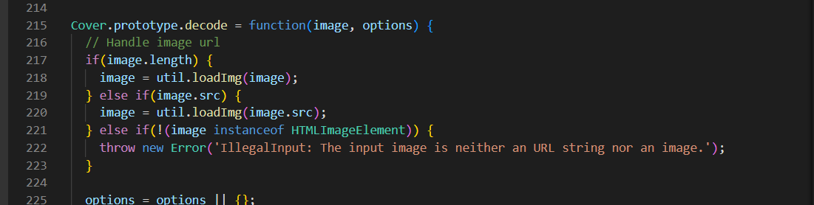
Hidden Messages Everywhere: How
This what I used to code my front end implementation of a steganography library:
2. Steganography.JS
Notes:
The second object from the library I’m going to be using is the steg.decode function which takes in the encoded image and returns a string.

Slide 17
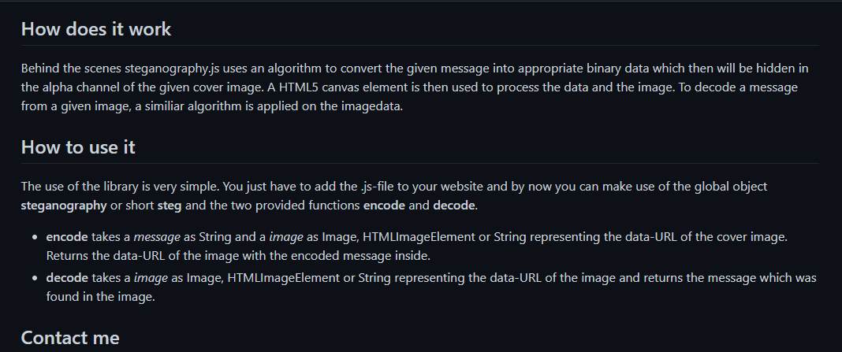
Hidden Messages Everywhere: Code Plan
Notes:
It’s always a good idea to plan your code out before writing it. So right here is a sort of a a mental map of how I intended to code out my steganography suite. Looking at the GitHub for the steganography.js helped me out considerably. Even though this sort of reiterates what two arguments I’m using from the steganography suite I found it useful to help me code. For example if you read through what encode function takes it will need a way of uploading an image file, a way of getting the image URL, and field to write the encoded message and other things like that.

Slide 18
Hidden Messages Everywhere: Code Plan
File Input to insert the image file. (HTML)
Function that reads the reads the image data.(JS)
A way to see the image being uploaded (HTML)
A way to write a secret message.(HTML)
Function that will encode the message (JS)
A way to display the encoded image (HTML)
A field that allows you to upload an encoded message (HTML)
Function that decodes an encoded image (JS)
A text display that shows the encoded message (HTML)

Slide 19
Hidden Messages Everywhere: Code Presentation.

Slide 20
Hidden Messages Everywhere: Code Experiment- Unlock Your Curiosity

Slide 21

Hidden Messages Everywhere: Code Experiment- Unlock Your Curiosity
Notes:
My inspiration for the unlock your curiosity website design was The Cosmopolitan of Las Vegas site. I like their use of black and white with the accent color being purple that gives just a hint of mystery.

Slide 22
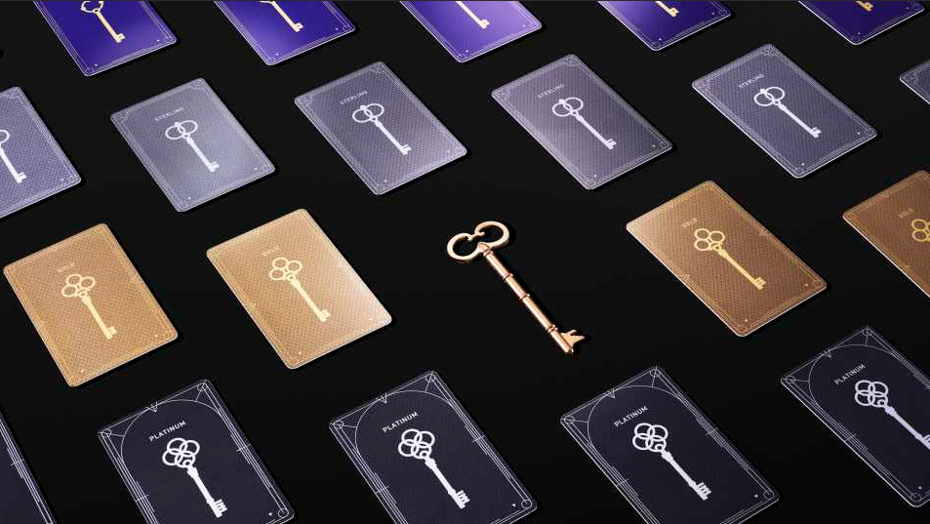
Hidden Messages Everywhere: Code Experiment- Unlock Your Curiosity
Notes:
This is also where I got the idea to use old skeleton keys because their Casino rewards card have this motif on them.

Slide 23
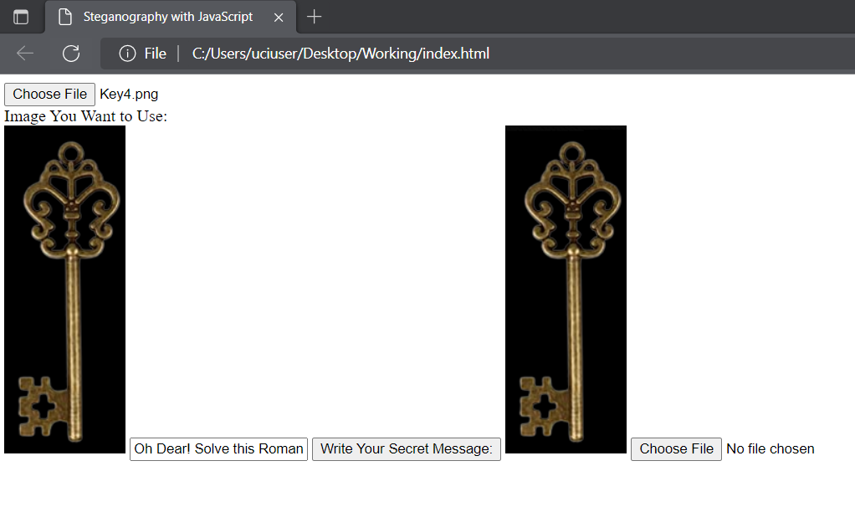
Hidden Messages Everywhere: Code Experiment- Unlock Your Curiosity
Notes:
I was also able to use my existing steganography code that was my demonstration to encode all the keys for the website.

Slide 24
Hidden Messages Everywhere: Code Experiment- Unlock Your Curiosity
1)Sorry Wrong Key. Hint: How can you make six into an odd number?
Remove the letter S and you have IX which is 9 in roman numerals.
2)Love is always the answer but not this time. Hint: You need to add five.
Love is a four letter word adding 4 to 5 is 9
3)Sorry Wrong Key. Hint: Solve this roman equation If ‘n’ means ‘and’, solve this Roman equation: the answer is millenia ahead.
M n I. 1001 which is binary for 9.
4)Sorry Wrong Key. Non mais en Allemand.
No in German is Nein -> Nine
5)Sorry Wrong Key. Both Windows and Apple skipped over me.
Both Windows and Apple skipped over version 9 of their systems.
Notes:
And just in case you were curious about all the riddles. All the riddles encoded in the keys point to the number nine.

Slide 25
Round Up and Questions
Notes:
Hopefully, you’ve all found this code implementation of steganography illuminating and can understand a little better what does go on under the hood of a tool like steghide. While I hope to one day be able to code my own steganography algorithm, but in the meantime this front end implementation using Javascript will have to do. Are there any questions?

